Slide 1
Figure 1
Uninfected
Latent infection
Symptomatic,
non-TB
Active disease, asymptomatic, smear-positive
Active disease, asymptomatic, smear-negative
Symptomatic, without TB
ACF screening
ACF screening
Active disease, symptomatic, smear-positive
Active disease, symptomatic, smear-negative
Temporarily dropped out of care cascade
ACF bacteriological testing
ACF bacteriological testing
False-positive, on treatment
Sought care and awaiting diagnosis
On treatment
Treatment completed, low relapse risk
Treatment interruption, high relapse risk

Slide 2
Figure 2

Slide 3
Figure 3

Slide 4
Figure 4

Slide 5
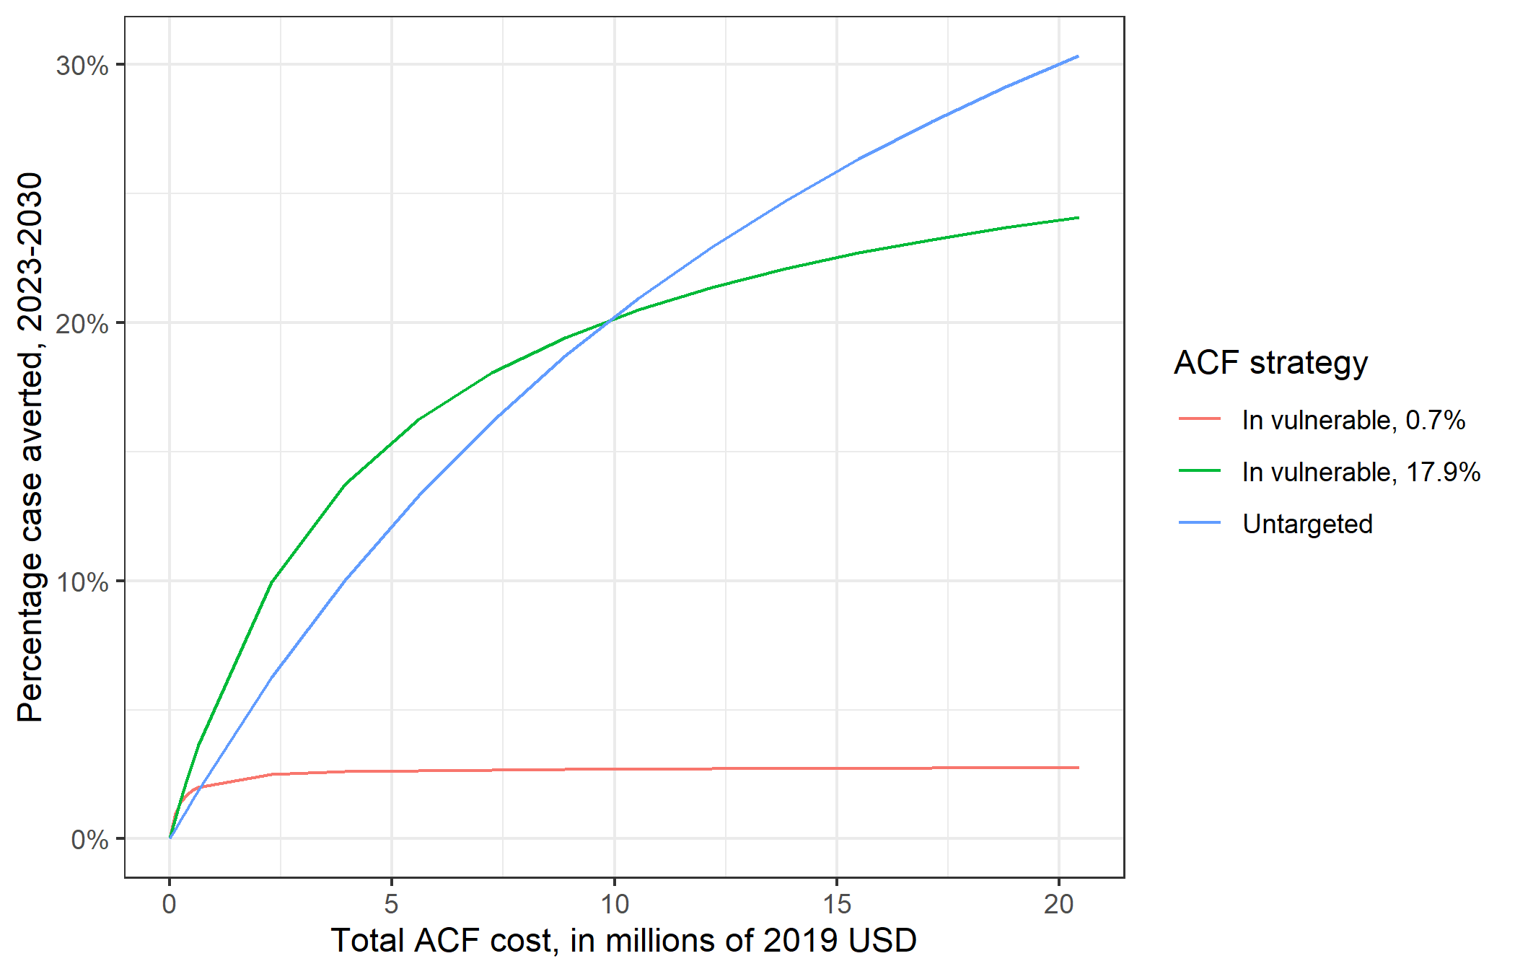
Figure 5

Slide 6
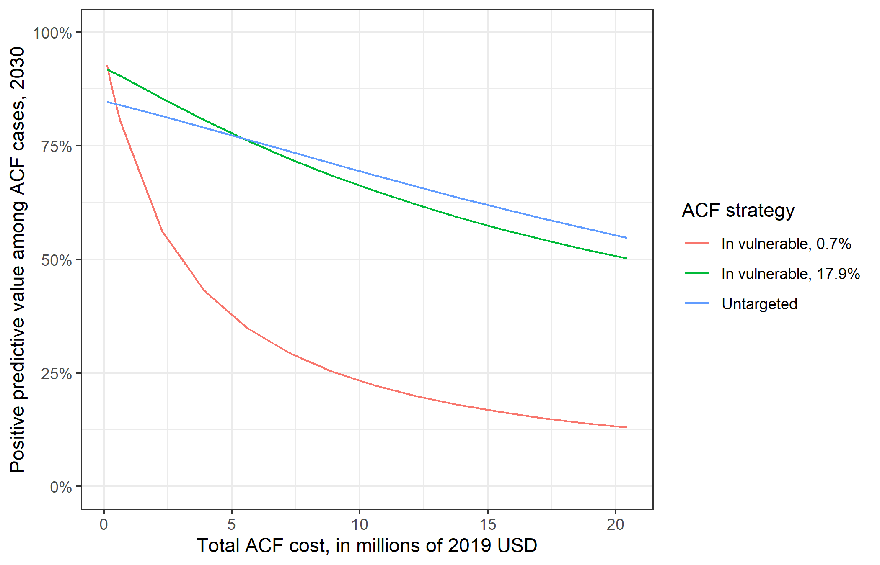
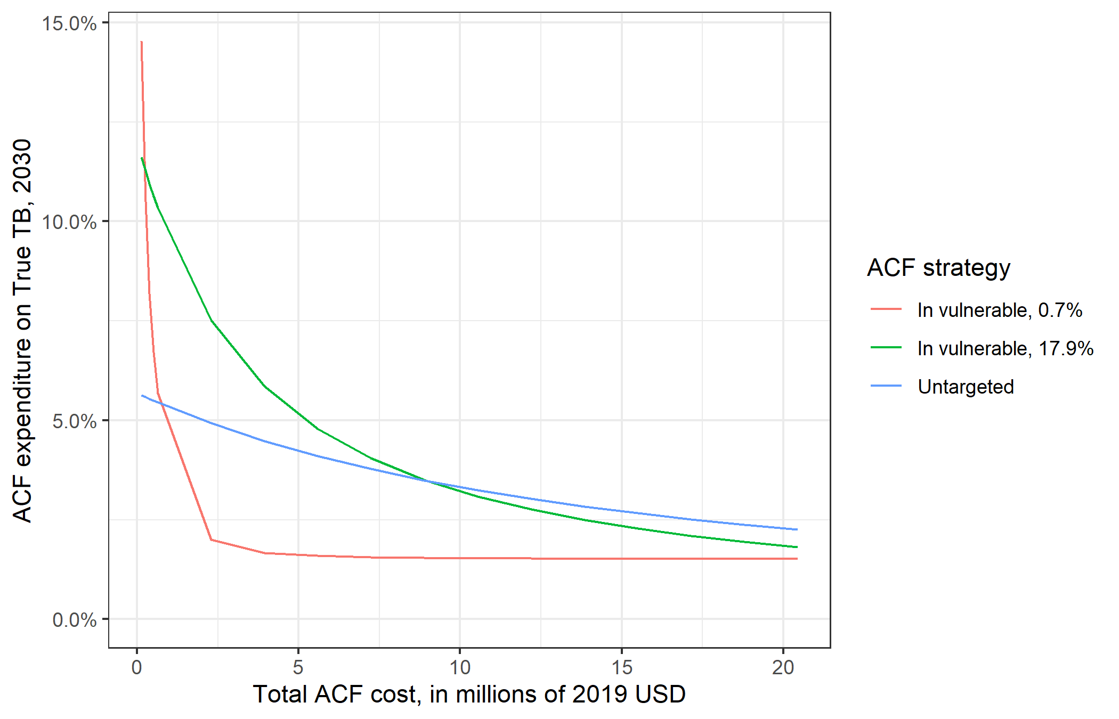
Figure 5

